Slide 1
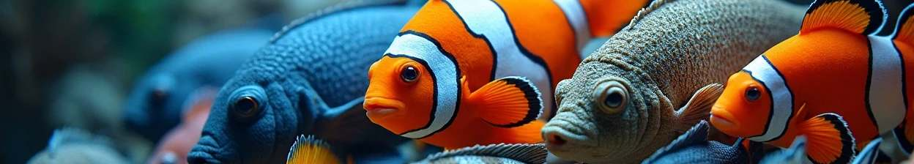

Multiclass Fish Image Classification
Author: Sudharsan Ceo
Created with Pi

Slide 2


CONTENTS
. Title Slide
. Project Overview
. Domain & Problem Statement
. Business Use Cases
. Approach Overview
. Model Performance Table
. Model Evaluation & Metrics
. Deployment (Streamlit App)
. Key Results & Insights
. Conclusion & Future Work

Slide 3

. Title Slide
Title: Multiclass Fish Image Classification
Subtitle: A Deep Learning Approach using CNN & Transfer Learning Presented by: Sudharsan Udhayakumar
College: IFET College of Engineering

Slide 4
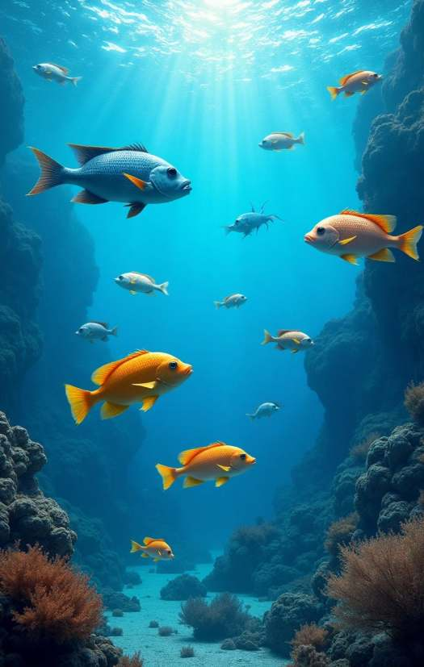

. Project Overview
Objective: Classify fish species using Deep Learning.
Compared CNN and multiple pre-trained models.
Deployed a Streamlit web app for real-time fish image prediction.

Slide 5
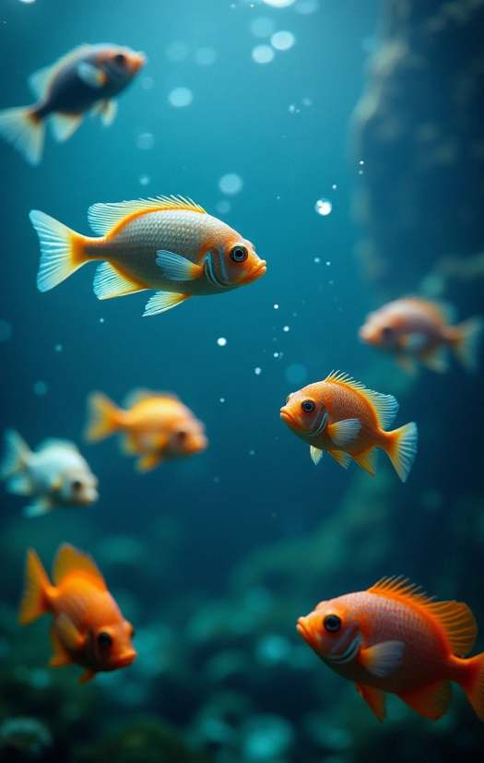
. Domain & Problem Statement
Domain: Image Classification
Problem: Accurately identify fish categories using CNN and Transfer Learning. Includes training, fine-tuning, evaluation, and deployment.

Slide 6


. Business Use Cases
🎯 Improved accuracy using transfer learning.
💻 Streamlit app for real-time fish predictions.
📊 Compared models to select the best-performing one for production.

Slide 7

. Approach Overview
Model Training
custom CNN + fine-tuning of pre-trained models (VGG , ResNet , MobileNet, InceptionV , EfficientNetV B ).
Data Preprocessing & Augmentation
Model Saving & Deployment
scaling, rotation, zoom, flip.
saved best models in .h / .keras and integrated with Streamlit.

Slide 8
. Model Performance Table
Model | Type | Test Accuracy
Custom CNN | From Scratch | . %
VGG | Transfer Learning | . %
ResNet | Transfer Learning | . %
MobileNet | Transfer Learning | . %
InceptionV | Transfer Learning | . %
EfficientNetV B | Transfer Learning | . %
🧩 Placeholder below for bar chart comparison visualization.

Slide 9
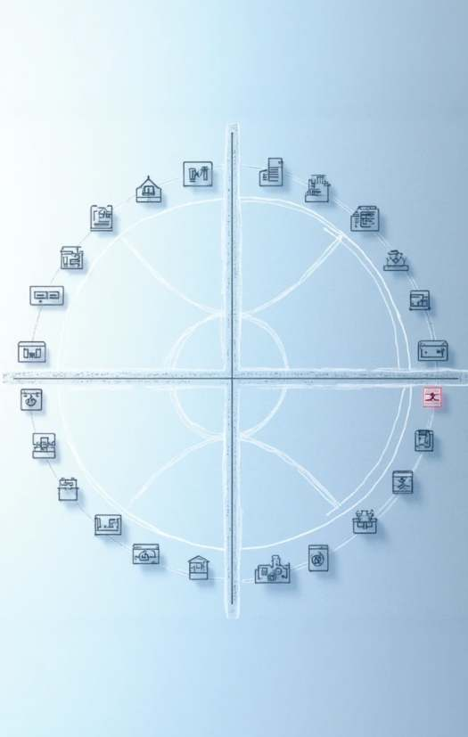
. Model Evaluation & Metrics
Metrics Used: Accuracy, Precision, Recall, F -score, Confusion Matrix Placeholders for:
Accuracy vs Epochs plot
Loss vs Epochs plot
Confusion Matrix image

Slide 10
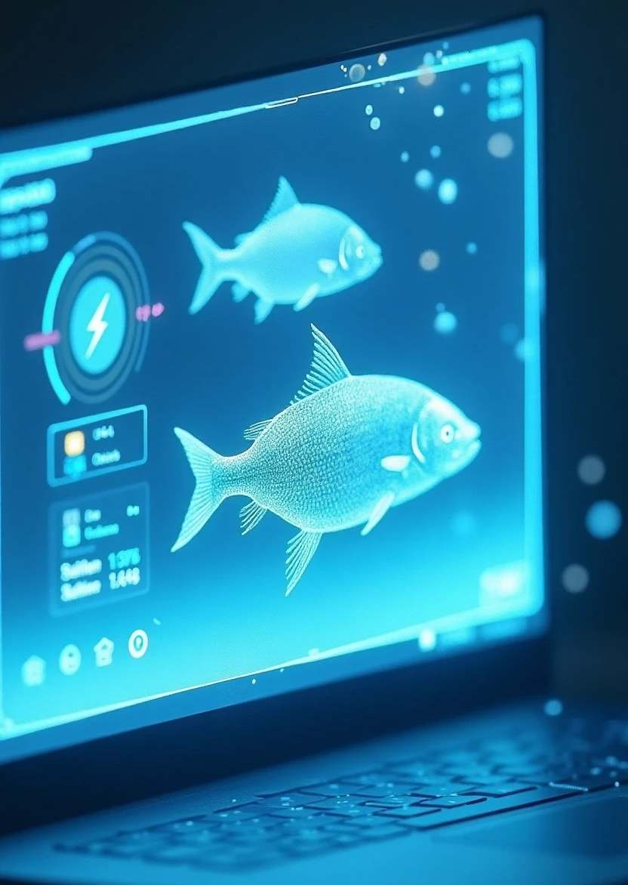
. Deployment (Streamlit App)
Upload fish image → Model predicts species.
Shows predicted class & confidence score. Uses saved .keras / .h model.\
🖼 Placeholder for Streamlit App Screenshot

Slide 11

. Key Results & Insights
Top Models: MobileNet ( . %), InceptionV ( . %).
Custom CNN & VGG also strong performers.
ResNet moderate; EfficientNetV B underperformed due to layer freeze setup.
Transfer learning clearly enhanced accuracy.

Slide 12
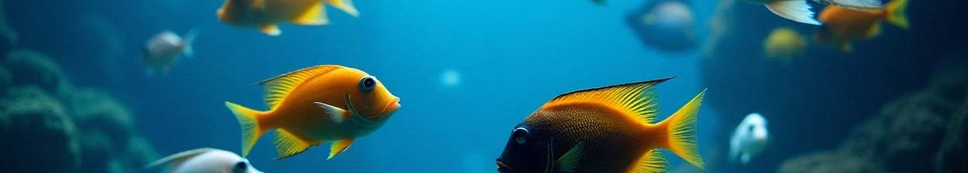
. Conclusion & Future Work
Deep learning models achieved high accuracy on fish classification.
Future Work:
Fix EfficientNet training
Expand dataset
Optimize hyperparameters
Improve Streamlit UI
GitHub repo includes code, models, and documentation.

Slide 13
Thank You

